Slide 1
9 Ways to Make WordPress better with AI
WCEU 2020 Online - David Lockie, Pragmatic
@divydovy
Notes:
Hi, my name’s David Lockie and I’m CEO at Pragmatic - a digital agency based in Brighton that specialises in WordPress.
I have a passion for WordPress and also for technology and futurism. Over the last few years I’ve been increasingly interested in AI and have started to research its impact on WordPress.
Today I want to share some cool things I’ve found along the way, some of my thinking around AI and some ideas about what lies ahead for WordPress. I want to help you to gain a more nuanced understanding of what AI technologies are, give you 9 examples of how they can be integrated into WordPress today and then put a little time into thinking about what opportunities and challenges lie ahead of us as a WordPress community.
A bit of housekeeping:
I’m going to talk for 25-30 mins (depending how carried away I get) but will remain available in the networking track afterwards and I’m always on Twitter @divydovy for Q&A
These slides will be available on the Pragmatic blog as soon as we can upload them - including speaker notes with a full transcript and lots of links to resources

Slide 2
WordPress today
@divydovy
Notes:
You’re listening today because you care about WordPress.

Slide 3
36%+
@divydovy
Notes:
You’re not the only one. WordPress is huge:
Huge adoption
Huge number of sites
Huge data
Huge ecosystem
Huge variability
Huge economy
Huge stakes

Slide 4
An incredible community
@divydovy
Notes:
WordPress is more than anything a community - some amazing people, organisations and businesses:
Open source contributors and maintainers
End users
Agencies
Freelancers
Software vendors
Support providers
Hosters

Slide 5
The world’s #1 CMS
@divydovy
Notes:
Gutenberg really is great and gives people a world class page building and editing experience. Other WordPress page builders are fantastic too.
WordPress is an incredible tool for helping people communicate online and there’s immeasurable value in that.

Slide 6
AI is coming
@divydovy
Notes:
But the world is much bigger than WordPress. And even a huge project backed by many, many people is not free from the risk of disruption.
The ways in which AI could impact WordPress are at once easy and difficult to predict. We know it’s going to happen and can guess at some of the specifics but if I had a killer idea for exactly what AI+WordPress looked like, I’d be building it right now because it’s surely one of the biggest commercial opportunities out there.
The current paradigm of the web is largely people planning, creating, publishing and experiencing content by and for each other. But we’re already seeing that paradigm shift towards the involvement of machine intelligence at every step from planning through to ‘experiencing’ content.

Slide 7
Four Industrial Revolutions
1750
1800
1850
1900
1950
2000
2050
FIRST - 1784
Mechanical production, railways, steam power
SECOND - 1870
Mass production, electricity
THIRD - 1969
Computers, electronics, automated production
FOURTH - NOW
AI, robotics, big data, AR, etc
@divydovy
Notes:
Of all the trends that could disrupt WordPress, it seems clear to me that AI is the most important. It stands to be the defining technology of our generation. Creating wealth, helping people solve challenges that are inherently part of our very humanity.
The fourth industrial revolution, and we’re just at the start of this journey.
Where it will take us is up to us. But I dare to image some incredible things ahead.
Source: https://twitter.com/erictopol/status/701465779389083648

Slide 8
The only way to make peace with technology is to make peace with ourselves.
https://www.nytimes.com/2019/12/05/opinion/digital-technology-brain.html
Tristan Harris
Center for Humane Technology
@divydovy
Notes:
AI has the opportunity to help us to be better than we can be without it but as with all technologies, it’s neutral and can be used for both good and bad. Especially at this troubled time in our history, a plea to our community as technologists to use these incredible technologies for good.
Source: https://www.nytimes.com/2019/12/05/opinion/digital-technology-brain.html

Slide 9
2019 | Win world series poker
2026 | Write high school essay
2027 | Successfully mimic any musician
2028 | Generate top 40 song
2028 | Generate creative video
2029 | Self-driving trucks
2049 | Write New York Times best-seller
2065 | AI-powered robots largely replace surgeons
@divydovy
Notes:
Disruption is not something we can entirely control and will have all kinds of impacts. This is a timeline of when AI will achieve parity with different human skills and jobs.
Just last week there was news that Microsoft has replaced 27 journalists with AI for editing the MSN homepage: https://amp.theguardian.com/technology/2020/may/30/microsoft-sacks-journalists-to-replace-them-with-robots?CMP=Share_iOSApp_Other&__twitter_impression=true
For how long will ‘WordPress developer’ be a job?
Sources: https://www.weforum.org/agenda/2018/03/timeline-of-creative-ai/, https://venturebeat.com/2019/07/11/facebooks-ai-beats-human-poker-champions/
See also: https://www.sciencealert.com/experts-think-this-is-how-long-we-have-before-ai-takes-all-of-our-jobs

Slide 10
Beware the hubris
@divydovy
Notes:
A further note of caution that just like a successful investor, WordPress’ historic success is no guarantee of future performance.
SaaS platforms - including Squarespace, Wix, Shopify, Webflow, Adobe, Sitecore, Medium, Facebook’s own stores and ven some specifically-powered AI website builder services: https://heyleia.com/, https://www.bookmark.com/ are all using AI. Today.
NOTES: Also see https://zyro.com/, https://thegrid.io/ (the latter has gone quiet and there’s talk of it being a scam but the idea certainly isn’t unbelievable)

Slide 11
https://www.filmstories.co.uk/features/the-terminator-sequel-trilogies-that-never-were/
@divydovy
Notes:
So yes, the AI is coming!
It’s apparently the law that every deck about AI must include reference to The Terminator and Skynet, so now I’ve included this reference, let’s move past this now I hope and onto a better understanding of AI in reality.
Image credit: https://www.filmstories.co.uk/features/the-terminator-sequel-trilogies-that-never-were/

Slide 12
What is AI?
@divydovy
Notes:
What is AI and what can it do?

Slide 13
The AI Cloud
Proprietary, Homegrown AI Languages
AI Chipsets
Cognitive Computing
Bots
Marketplaces For AI Algorithms
More Consolidation in AI
Consumer-Grade AI Applications Debut
Digital Assistants Become Ubiquitous
A Bigger Role For Ambient Interfaces
Deep Linking Everywhere
Making AI Explain Itself
Accountability and Trust
Hidden Bias Leads To Big Problems
China’s AI Boom
Real-Time Machine Learning
Natural Language Understanding (NLU)
Machine Reading Comprehension (MRC)
Natural Language Generation (NLG)
Generative Algorithms For Voice, Sound and Video
Image Completion
Predictive Machine Vision
Much Faster Deep Learning
Reinforcement Learning and Hierarchical RL
Continuous Learning
Multitask Learning
Adversarial Machine Learning
https://medium.com/@webbmedia/2019-emerging-tech-trends-1ecf2f7a3bed
AI isn’t a single technology
@divydovy
Notes:
AI is a pretty abused term. It’s best considered a family of technologies and trends that covers a lot of ground.
We already use AI to help us almost every minute of the day in products like Google search, Google Maps, Spotify recommended playlists or Google assistant recommended content.
From Future Trends Institute Tech Trends Report 2019 some of the most important technologies are:
Natural Language Understanding (NLU)
Machine Reading Comprehension (MRC)
Natural Language Generation (NLG)
Generative Algorithms For Voice, Sound and Video
Image Completion
Adversarial Machine Learning
https://medium.com/@webbmedia/2019-emerging-tech-trends-1ecf2f7a3bed
Those trends are:
The AI Cloud
Proprietary, Homegrown AI Languages
AI Chipsets
Cognitive Computing
Bots
Marketplaces For AI Algorithms
More Consolidation in AI
Consumer-Grade AI Applications Debut
Digital Assistants Become Ubiquitous
A Bigger Role For Ambient Interfaces
Deep Linking Everywhere
Making AI Explain Itself
Accountability and Trust
Hidden Bias Leads To Big Problems
China’s AI Boom
Real-Time Machine Learning
Natural Language Understanding (NLU)
Machine Reading Comprehension (MRC)
Natural Language Generation (NLG)
Generative Algorithms For Voice, Sound and Video
Image Completion
Predictive Machine Vision
Much Faster Deep Learning
Reinforcement Learning and Hierarchical RL
Continuous Learning
Multitask Learning
Adversarial Machine Learning

Slide 14
AI is about knowledge
@divydovy
Notes:
A good way to think about AI is to think about knowledge. How it’s created, managed and used.

Slide 15
Wisdom | Revert the site back to pre-Akismet update and notify the site administrator there’s been a problem
Understanding | There was a problem updating Akismet because it triggered a fatal PHP error
Knowledge | An update process was started for akismet and triggered a fatal PHP error
Information | akismet is a plugin, update started is an action, fatal error is a PHP error
Data | “akismet”, “update started”, “fatal error”
@divydovy
Notes:
So what’s knowledge? This is a hierarchy of knowledge.
You don’t need intelligence for data or information, but you do for knowledge, understanding and wisdom.
Currently much knowledge, understanding and wisdom in the WordPress space remains in the heads of humans. Over time, we’ll see this baked into AI.

Slide 16
AI outcomes
Perception
Notification
Suggestion
Automation
Prediction
Prevention
Situational Awareness
@divydovy
Notes:
With knowledge, understanding and wisdom, these are the sorts of things that AI can generate as outcomes. As we go right, the AI needs more learning.
Perception - what’s happening now?
Notification - what do I need to know?
Suggestion - what do you recommend?
Automation - what should I always do?
Prediction - what can I expect to happen?
Prevention - what can I avoid?
Situational awareness - what do I need to do right now?
I imagine that for many of us, examples of what those outcomes look like with WordPress spring naturally to mind.
Inspired by https://davidcummings.org/2016/12/28/seven-spectrum-of-outcomes-for-ai/

Slide 17
@divydovy
https://hi.stamen.com/just-the-streets-maam-f423fd694674?gi=fc0bdc089efc
The travelling salesperson
Notes:
Let’s look at a specific example of a hard problem that AI can help us solve.
A salesperson needs to find the most efficient way to make that day’s stops - let’s say that the objective is simply to find the shortest total distance.
Image credit: https://hi.stamen.com/just-the-streets-maam-f423fd694674?gi=fc0bdc089efc
Source: https://www.raconteur.net/technology/algorithm-for-the-masses (Props to Prof Hulme at Satalia for the calculations.)

Slide 18
@divydovy
The travelling salesperson
2 stops = a few routes
Human brain is capable (maybe with an argument)
Notes:
Two stops is pretty trivial, it’s the kind of decision we make by second nature when we know the area and although there might be some inefficiency (and if you’re travelling with your family, probably an argument!) the cost of that inefficiency isn’t particularly high.

Slide 19
@divydovy
The travelling salesperson
10 stops = 3M routes
@ 1M calculations/s = 4s
Notes:
But when we go to ten stops, the number of route variations has grown to over 3 million. Still not a huge problem to solve for the salesperson. Using raw calculation power, she can solve for the optimum route in a brute force way in 4s given a 1 million calculations/s processing throughput.

Slide 20
@divydovy
The travelling salesperson
14 stops = 87B routes
@ 1M calculations/s = 1d
Notes:
As the number of stops increases, the amount of time needed increases in a non-linear way. So taking 14 stops would need a whole day using the same calculations and the costs of getting it wrong start to add up - i.e. the difference between shortest and other routes can be significant.
Of course, not all routes are equal and there exist algorithms which specialise in solving problems like this. For example, you can quickly rule out some routes like going from the very left hand dot to the very right hand one, or not doing the two dots close together in sequence.
So we need to use an algorithm, but there are several algorithms and even figuring out which algorithm to use is a hard problem.

Slide 21
@divydovy
The travelling salesperson
20 stops = 87B routes
@ 1M calculations/s = 20B years
Notes:
By the time we’re at 20 stops, it would take longer than the age of the universe to solve this problem using raw compute power. We must use an algorithm and the choice of algorithm becomes very important.
Machine learning is very good at solving optimisation problems like ‘which algorithm would be best to solve this problem?’
Shout out to all you fact-checkers counting my dots for me.

Slide 22
Better WordPress with AI
@divydovy
Notes:
Now with a slightly richer and more granular toolkit with which to think about AI technologies and the certain knowledge that AI is going to play a part in the future of WordPress one way or another, what are the ways we could make WordPress better with AI?
When we think about AI, it often seems far away from WordPress, and there’s some good reason for that. AI uses different technologies than WordPress, requires huge datasets and significant compute power - most WordPress sites run with limited databases and even more limited resources.

Slide 23
WordPress + AI today
@divydovy
Notes:
When we talk about augmenting WordPress with AI, we’re always talking about external tools and services that integrate with WordPress.
It’s important to note that there are in fact a bunch of ‘everyday’ plugins that already use AI - e.g. Akismet, Jetpack’s proofreading service, Sucuri’s DDOS protection

Slide 24
WordPress + AI in 5 years
@divydovy
Notes:
Often when I’m trying to think about the near future, I find it helpful to zoom out and jump to 5 or 10 years in the future - that makes it easier to then fill the gap between now and then.
Here’s where I got to:
It’s Monday morning and you’ve finally been given the go-ahead to revamp your company’s website. You’re a fan of WordPress so it’s a no-brainer that you’re going to check out WordPress first. You head over to wordpress.org and submit your current site’s URL to the AutoPress service.
The service crawls your current site and queries a couple dozen other critical sites like Facebook, Google and Amazon. It detects your current site’s integrations and requests permission to query those data sets. You allow this because WordPress is part of a consortium of trust-first technology providers.
Next, AutoPress asks you a few questions to understand your motivation, business goals, resources and current pain points. From there, you’re asked a series of questions that probe your appetite for adding new features and functionality, based on trends the service sees and opportunities it perceives as relevant.
From the information on your site, about your site, the answers you give and what it understands about your business and competition, AutoPress generates a brand new site, migrating and transforming the content, adding your branding and pre-configuring all your current integrations. You swipe through a few options before ‘swiping right’ on a site that looks and feels exactly as you want it.
With the site ready to get pushed to production, you engage a content AI expert service that will create draft content for you to review and publish over the next four quarters to help keep the site fresh and relevant. Of course, you know you’ll hit publish after a quick scan of the content, but for legal reasons the AI can’t publish without your explicit action - kind of the content AI version of ‘the human in the loop’ for military drones.
You log off your machine for your morning coffee break, confident that the majority of the project is complete.

Slide 25
A better world with WP + AI
@divydovy
Notes:
So with that future in mind, what do I think are interesting ways that you can start augmenting WordPress with AI today, and what does the near future hold?

Slide 26
https://en.wikipedia.org/wiki/Content_management_system
[CMS is] a software application [for] the collaborative authoring for websites and may include text and embed [media] that display content and interact with the user.
@divydovy
Notes:
First, let’s ask ourselves what WordPress is. WordPress is a CMS. What is a CMS anyway?
Definition of a web CMS by Wikipedia: https://en.wikipedia.org/wiki/Content_management_system

Slide 27
https://en.wikipedia.org/wiki/Content_management_system
[CMS is] a software application [for] the collaborative authoring for websites and may include text and embed [media] that display content and interact with the user.
@divydovy
Notes:
How can we augment WordPress with AI? By breaking down what a CMS is and looking at ways to augment each part, as well as the system as a whole.

Slide 28
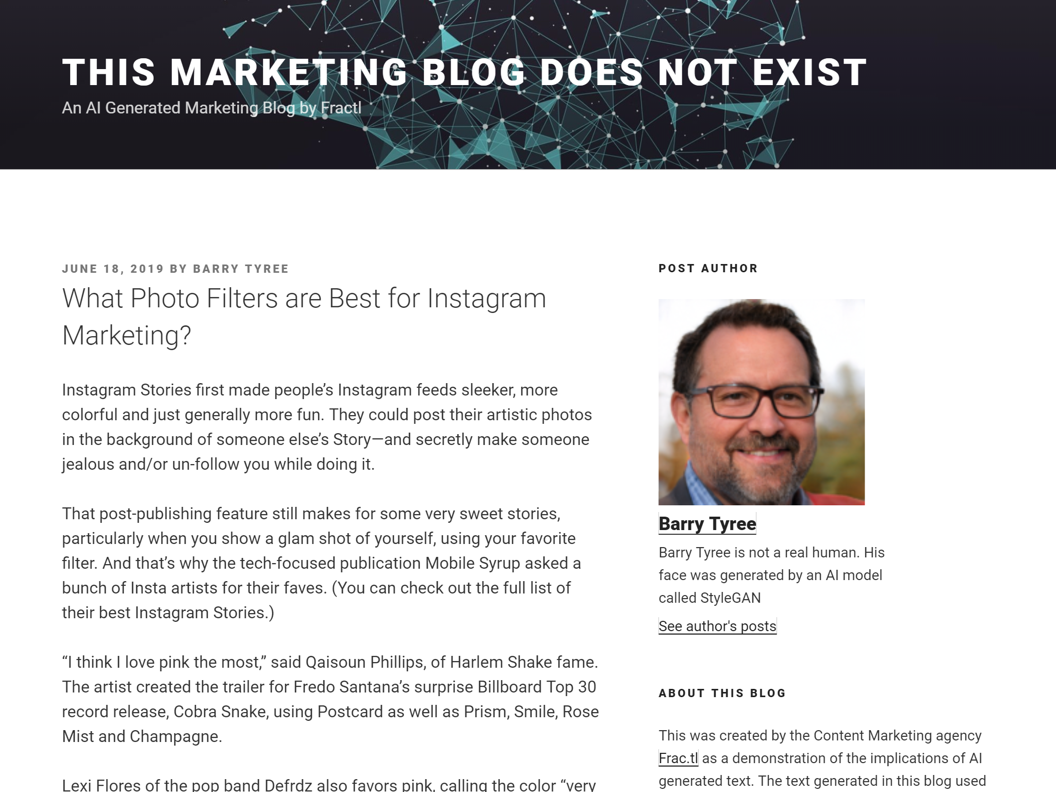
http://thismarketingblogdoesnotexist.com/
@divydovy
Notes:
Better collaborative authoring - automated content generation
How could AI help us better author content?
This example is http://thismarketingblogdoesnotexist.com/ which is a demonstration of an entirely automated marketing blog that uses Natural Language Generation. Yes it runs on WordPress.
Here, AI replaces people where low value or high value/low latency content generation matters e.g. sports, financial systems
Other examples of AI generation of content include:
Dreamwriter that can write a blog post of your talk by the time you sit down from delivering it: https://venturebeat.com/2020/01/10/chinese-court-rules-ai-written-article-is-protected-by-copyright/
Heliograf that produced 850 stories in 2017 alone: https://digiday.com/media/washington-posts-robot-reporter-published-500-articles-last-year/
And it doesn’t need to be content generation, it can also be content curation, per the example of MSN earlier.
Imagine no more tedious, low-value drafting and editing. Imagine more time to spend on things that are truly creative.
NOTES: Shout out to 10up’s white paper on this: https://10up.com/blog/2020/artificial-intelligence-machine-learning-whitepaper/ for the Heliograf pointer

Slide 29
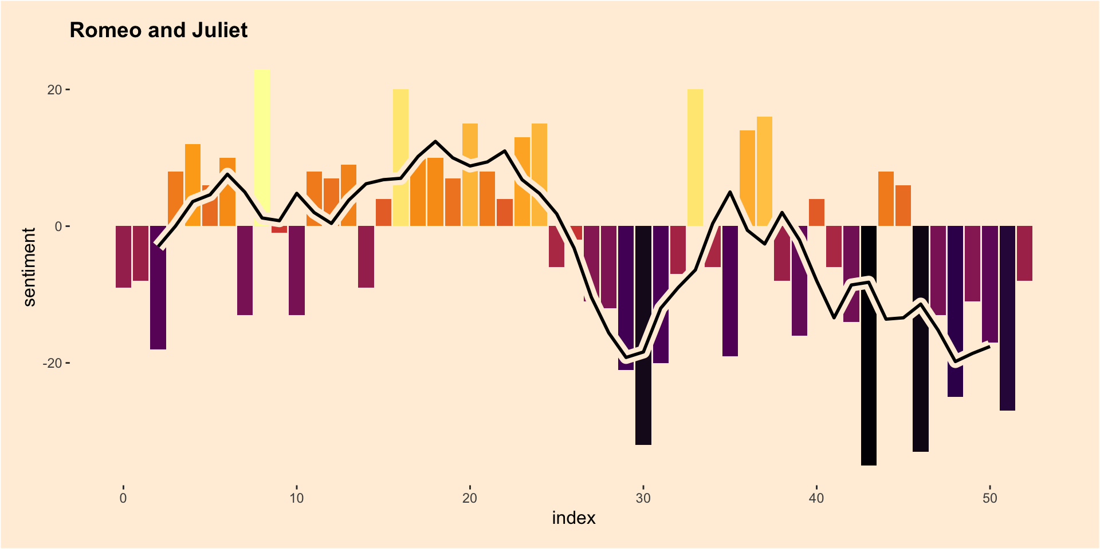
@divydovy
https://peerchristensen.netlify.app/post/fair-is-foul-and-foul-is-fair-a-tidytext-entiment-analysis-of-shakespeare-s-tragedies/
Notes:
2. Better collaborative authoring - helping humans write better content
How many of us are objective about our writing or even our thinking? If you think you are, go take the Implicit Association Test from Harvard: https://implicit.harvard.edu/implicit/takeatest.html - I guarantee you, you’re not.
Here, AI can help us mitigate human weaknesses by helping us understand things we produce objectively. This is a sentiment analysis of Romeo & Juliet - i.e. how happy or sad the book is over its length. Does writing positive or negative content rank better? Engage customers better? Why does one homepage image convert so much better than another? We are simply not good at objective analysis. It’s difficult, time-consuming and a job that machines can help us with.
You can use plugins like https://classifaiplugin.com/ from 10up and https://wordpress.org/plugins/watsonfinds/ today to analyse the sentiment of your WordPress content.
Other examples of how AI can help humans create better content include:
Automated tagging, language detection and entity analysis
Predictions for better content planning - Parsely Currents, Narrative Engine
Suggestions e.g. autocorrect spelling/grammar, best time to publish, etc
Imagine becoming a truly great writer, with personal tuition from an expert AI, such that all the content you write (and read) is rich, engaging and underpinned by semantic schema such that the content can automatically be served up in almost any format.

Slide 30
https://azure.microsoft.com/en-gb/services/cognitive-services/computer-vision/#features
@divydovy
Notes:
3a. Better collaborative authoring - automating routine tasks
AI can also help us be more efficient and to produce better quality products as a result. A really important way in which we can all do better is accessibility.
This is a photo of a man on a skateboard. For those of us that can see, that’s obvious. For those of us that can’t, all too often this is an image without a description.

Slide 31
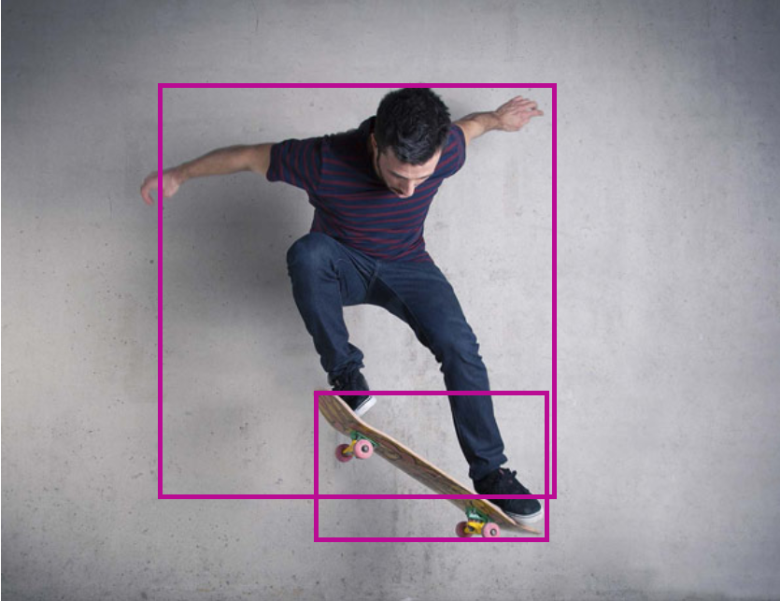
Objects | "object": "Skateboard", "confidence": 0.903 "object": "person", "confidence": 0.955
Tags | "skating", "person", "man", "outdoor", "riding", "sport", "skateboard", "young", "board", "air", "shirt", "black", "boy", "jumping", "side", "park", "trick", "ramp", "doing", "hill"
Caption | "a young man riding a skateboard", "confidence": 0.809844
https://azure.microsoft.com/en-gb/services/cognitive-services/computer-vision/#features
@divydovy
Notes:
3b. Better collaborative authoring - automating routine tasks
Here’s what visual cognitive services can tell you about the image. In this case, Azure’s Computer Vision - you just send an image to an API and you get structured data back.
I’ve edited the results for clarity but would you have thought to add all these tags? How about the caption? Not exactly Shakespeare, but a lot better than nothing.
There are several services that offer this sort of media management through WordPress plugin integration including: https://wordpress.org/plugins/automatic-alternative-text/, Cloudinary (which is baked into Altis by Human Made) and others
SEO is another task that can be automated to some extent e.g. via https://wordpress.org/plugins/wordlift/
Imagine a world in which everyone, everywhere can benefit from the collective knowledge and wisdom of humanity in whichever format suits them at that particular time.

Slide 32
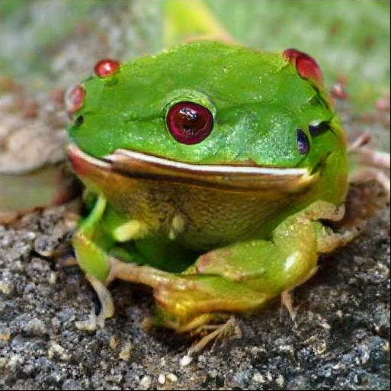
https://twitter.com/memotv/status/1046215376386822145?s=12
@divydovy
Notes:
4a. Better media to embed
Next, straight up machine-generated visual content.
This is one of my favourite AI technologies - visual generative adversarial networks. This is essentially two AIs - one that tries to make frogs, and another to judge how successful it was. Here’s a GAN trying to figure out what a frog looks like.
Source: https://twitter.com/memotv/status/1046215376386822145

Slide 33
https://www.cunicode.com/works/confusing-coleopterists
@divydovy
Notes:
4b. Better media to embed
But that frog is an amusing example, not a true representation of the state of the art. This is a screen-full of machine-generated beetles using Machine Learning trained on a huge open source set of beetle images (via https://www.cunicode.com/works/confusing-coleopterists) and a GAN to generate the images. I have a printed version of this on my desk.
This is a great example of the value of open source - that by making information open, we can allow others to create on top of it.

Slide 34
https://www.thispersondoesnotexist.com/
@divydovy
Notes:
4c. Better media to embed
And how about this guy? Doesn’t exist either. Credit https://www.thispersondoesnotexist.com/. More work by machine learning and GANs.
And the possibilities are almost endless for better media to embed, including:
AI meme generator https://imgflip.com/ai-meme
Create art from snapshots: https://venturebeat.com/2016/07/25/with-10-million-downloads-on-ios-prisma-now-lets-android-users-turn-their-photos-into-works-of-art/
Making it easy for everyone to produce professional quality media e.g. Produce studio-quality with home-baked https://twitter.com/theGunrun/status/1252789873699745792 - Nvidia's RTX Voice tech looks AMAZING
Imagine that by the time you’ve written a headline, your WordPress site has auto-suggested an image to suit. Go one step further, imagine that your WordPress site has generated a unique image, just for your audience. And even in due course, video deepfakes on demand: https://deepfakesweb.com/

Slide 35
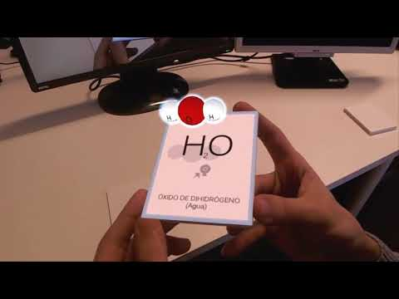
https://www.youtube.com/watch?v=Qi3h18wJJiI
@divydovy
Notes:
5. Better content distribution - beyond websites
What other digital experiences can WordPress help us manage content for?
This example seems far from WordPress but folks still need a place to upload a model, manage it and make it available for display in AR. That’s content management. I’ll be honest, I don’t know whether this example uses any AI or not but I can never resist including some AR in a presentation, it’s just so cool. I imagine if this went beyond a limited example, machine learning would be necessary to demonstrate more complex molecules.
A more tangible example might be using Microsoft’s Q&A Maker to automate the generation of a chatbot from FAQs, or adding voice interfaces (both for search and reading content).
In-game or in-app content
Voice https://wordpress.org/plugins/voice-dialog-navigation/
Create podcasts from written articles: https://wordpress.org/plugins/amazon-polly/, https://wordpress.org/plugins/play-ht/
Imagine content management in a digital world without restrictions on format, size or nature. AR/VR and AI together will change digital design for ever.
Credit: https://www.youtube.com/watch?v=Qi3h18wJJiI

Slide 36
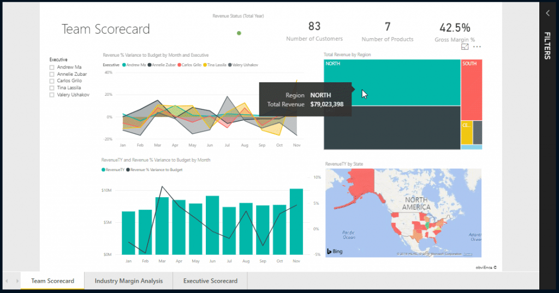
https://powerbi.microsoft.com/en-us/blog/easily-embed-secure-power-bi-reports-in-your-internal-portals-or-websites/
@divydovy
Notes:
6. Better display of content - beyond downloading spreadsheets
As organisations progress in their digital transformation, their ability to produce rich, interactive datasets improves (likewise their customers demand it)
Data rooms and visualisations through embedded PowerBI instead of spreadsheets and PDFs
PowerBI leverages the power of Microsoft Azure’s cognitive services to help aggregate datasets and suggest visualisations
Image source: https://powerbi.microsoft.com/en-us/blog/easily-embed-secure-power-bi-reports-in-your-internal-portals-or-websites/
Imagine being able to truly dive infinitely deeply into any topic. We talk about diving into a Twitter or Reddit rabbithole today but this would be next-level.

Slide 37
https://twitter.com/amandacosco/status/1083441666705498112?s=12
@divydovy
Notes:
7. Better interactions - personalisation
What are the website equivalents of this smart mirror? How can we make a website feel utterly tailored to an individual?
Offering Personalized Suggestions To Visitors - Bibblio
Improving search results - part of Elasticsearch
Credit: https://twitter.com/amandacosco/status/1083441666705498112?s=12
Imagine a website that tailored its content for you on-the-fly. What’s your personality type? How do you digest content best - video, text or animation? Is that the same at all times of the day? At the weekend? On desktop vs mobile?

Slide 38
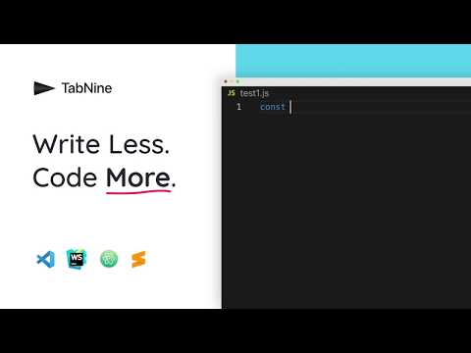
https://www.youtube.com/watch?v=TKLkXh_c-Gw
@divydovy
Notes:
8. Better software applications
Could AI help us to write better code?
TabNine is an application that was trained using deep learning on millions of open source code repos on Github which allows it to do auto-complete and auto-suggestion to an entirely different level - https://www.tabnine.com/blog/deep/
Imagine an IDE where we can simply describe what we want a function to do and have a program write it for us? Maybe even one that can predict what we’ll want.
Credit: https://www.youtube.com/watch?v=TKLkXh_c-Gw

Slide 39
https://github.com/features/security
@divydovy
Notes:
9. Better security
How can AI helping us create a better quality overall posture beyond the application itself?
Github now includes a security scanner that uses machine learning to help you create more secure code: https://www.theregister.co.uk/2020/05/06/github_releases_codescanning_tool/. Is this the best reason yet to move the WordPress code repos to Github?
Security e.g.
Bot protection with Cloudflare DataDome
Smart Plugin Manager by WP Engine
Imagine a global network of WordPress sites that act as a hive mind, automatically detecting threats and responding and self-healing.
Credit: https://github.com/features/security

Slide 40
@divydovy
Notes:
The WordPress project - better with AI?
We should also pause to talk about AI’s impact on the WordPress project itself.
Arguably WordPress should stand to benefit from AI in a greater way than its competitors - WordPress is fragmented and huge. For SaaS platforms the code and data structures are standardised (if huge) so the challenges they face are more easily solved with non-intelligent solutions. Obviously that’s not to say that what they do is simple or easy - I’m sure they’re pushing forward with AI technologies even more quickly than the WordPress project. What I mean is that we have more problems to solve as a community - solving auto-updates against heterogenous codebases, infrastructures and databases is exactly the kind of problem that AI technologies can help with.
So we have further to travel to be able to leverage the same degree of AI as our monolithic competitors, but also more to gain.
So let’s say there is created a WordPress AI. In fact, it’s almost certainly going to be a bundle of different modules that do different things. AutoPress might be one. Another might provide security augmentation, another accessibility, etc.
Who would own that AI - would it - itself be open sourced? If not, how would the open source project be affected by such a powerful suite of tools. One that would inevitably massively disrupt the WordPress ecosystem, perhaps putting whole classes of WordPress jobs at risk? Would that price be worth paying for software that could create so much more value for its users and the world at large?
In fact hang on
I can already think of companies that deploy modular plugin or plugins leveraging AI services that are connected to millions of WordPress sites. Often already leveraging AI technologies. There are several ecosystem giants that have the penetration, data and resources to introduce disruptive AI.
I want to be clear. This isn’t me beating on Automattic or Jetpack or Yoast or WP Engine, far from it. It’s inevitable - AI is a technology that currently relies on big data to train models, big connectivity to feed into the model and big computing resources to leverage them. It is almost unthinkable that these ecosystem giants aren’t investing heavily in AI technologies right now.
As the power of AI-integrated services increases, it’s going to start raising important questions about the relationship between the open source project and the larger companies in the space.
If you believe, like me, that what we’re doing in the WordPress community transcends a content management system and is instead an important experiment into how people can self-organise, then this is a key area in which we need show leadership.
How does WordPress benefit from AI whilst staying independent?

Slide 41
Back to today, ahead to tomorrow
@divydovy
Notes:
What can you do today?
Think about the threats and opportunities. What opportunities exist?
Auto-migration from HTML -> Gutenberg blocks
Auto-diagnosis of WSOD
A taxonomy co-pilot to help ensure consistency across editorial teams
Connecting and leveraging the network effect of so many WordPress sites - could we create the equivalent of Shopify’s new Shop app by creating a marketplace of all the millions of WooCommerce sites?
Auto-suggesting how to make WP posts more readable (e.g. ‘why not add an image now to help break up the flow of text’ or ‘this seems like a good quote’ - like a Clippy for WP)
Nocode layouts like Webflow - nocode Gutenberg blocks?
Automated responsive design analysis and fix suggestions
Automated intelligent QA for WP core and plugin developers (Yoast’s QA team is now the biggest team in the business - it must be incredibly difficult to be responsible for deployment on millions of sites that are so varied)
What challenges need fixing? Not just in WP but beyond.
Fake news
Accessibility
Diversity & Inclusion
Tech power centralisation - think about all the times I’ve mentioned Google, Microsoft and other tech giants in this presentation
Policy and governance for machine/people-integrated organisations
There’s plenty to work on.
So there we have it, 9 ways that you can augment WordPress with AI. I hope to have make this incredible family of technologies less opaque and to give you some inspiration and starting points to go and find out more.
Make no mistake, AI is both an existential risk and an incredible opportunity for WordPress. How we solve this challenge will inform humanity far beyond better content management.
It’s not a tomorrow thing, it’s a yesterday thing, let’s not let any more time slip by.

Slide 42
@divydovy
Notes:
Thank you
A massive thank you to the WCEU Online organisers who have taken on a massive challenge to put this event on.
Thank you also to the Pragmatic team, on whose shoulders I stand to be here today.
And thank you all for being part of this incredible community.

